Slide 1

Airplane Crash Analysis
Using Power Bi
Submitted By: Shreya Rana

Slide 2
Agenda
Project Overview
About Dataset
Analysis Queries

Slide 3
PROJECT OVERVIEW:
focuses on conducting a comprehensive analysis of airplane crashes and fatalities spanning from 1980 to 2023.

Slide 4
DATASET PREVIEW:
Date: Date of the airplane crash.
Time: Time of the airplane crash.
Location: Location where the airplane crash occurred.
Operator: Operator or airline involved in the incident.
Flight #: Flight number associated with the incident.
Route: Planned route of the flight.
AC Type: Aircraft type involved in the crash.
Registration: Registration details of the aircraft.
cn/ln: Construction or serial number of the aircraft.
Aboard: Total number of individuals aboard the aircraft.
Aboard Passengers: Number of passengers aboard the aircraft.

Slide 5
Aboard Crew: Number of crew members aboard the aircraft.
Fatalities: Total fatalities in the incident.
Fatalities Passengers: Number of passenger fatalities.
Fatalities Crew: Number of crew member fatalities.
Ground: Casualties on the ground, if any.
Summary: Brief summary or description of the incident.

Slide 6
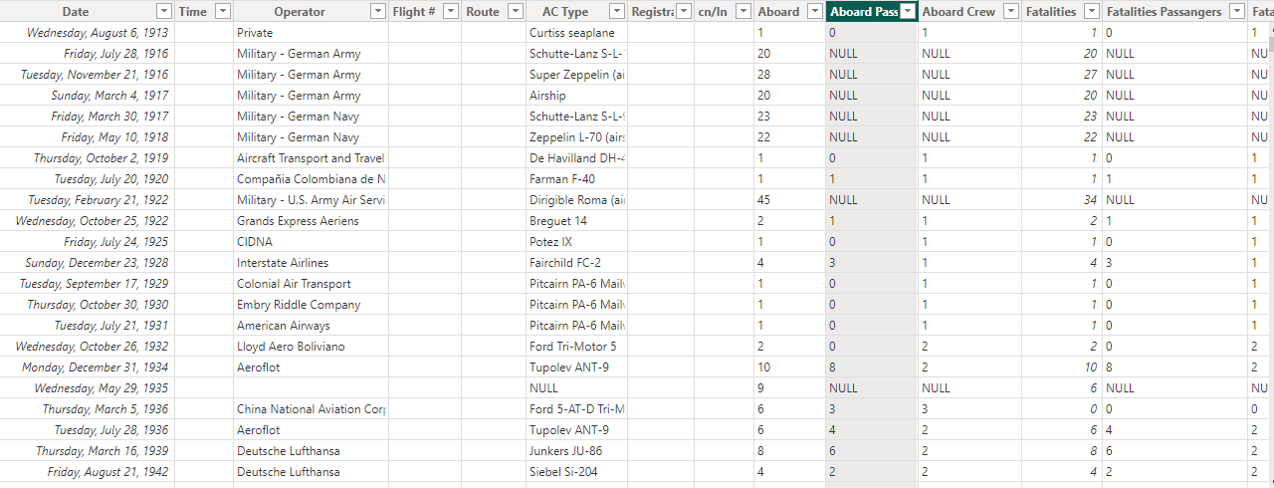

Slide 7
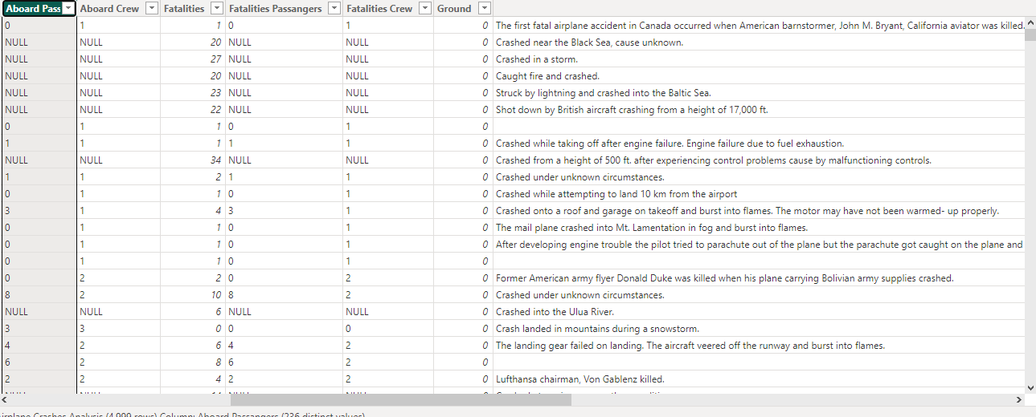

Slide 8
Analysis Queries

Slide 9
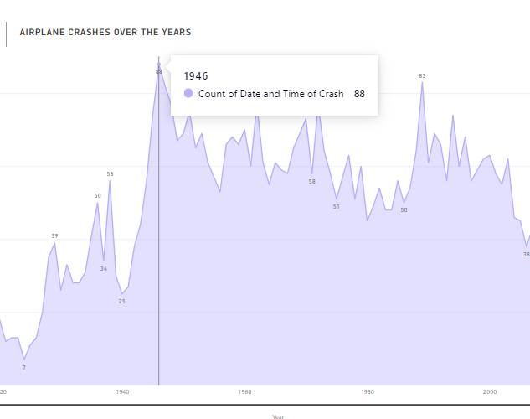
Temporal Analysis: - Explore temporal trends in airplane crashes over the years. - Identify patterns in the frequency and severity of incidents.
According to the analysis → Maximum count of airplane crashes occurred in the year of 1946

Slide 10
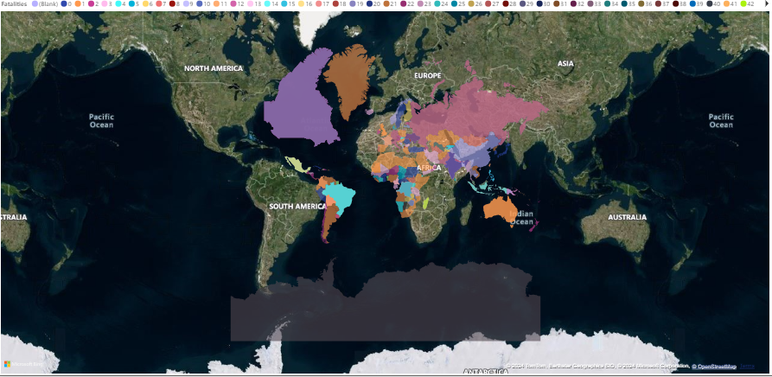
Geospatial Analysis: - Visualize crash locations on a map to identify hotspots. - Analyze the distribution of incidents across different regions.

Slide 11
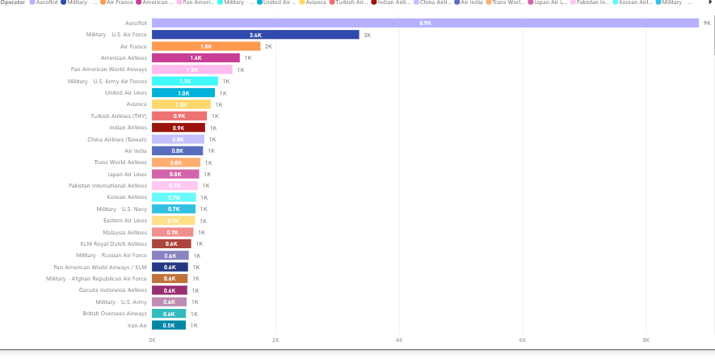
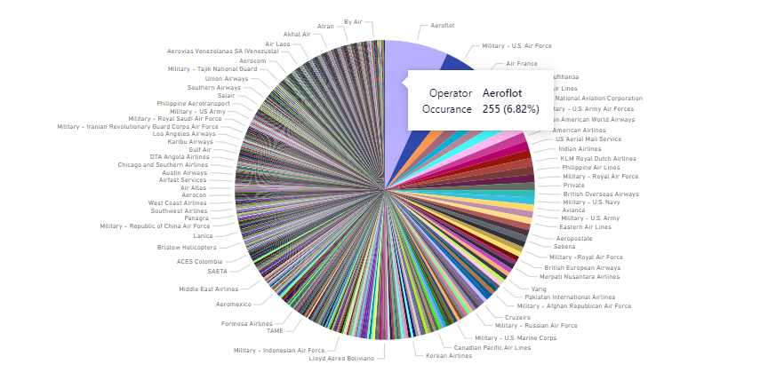
Operator Performance: - Evaluate the safety records of different operators and airlines. - Identify operators with higher incident rates.

Slide 12
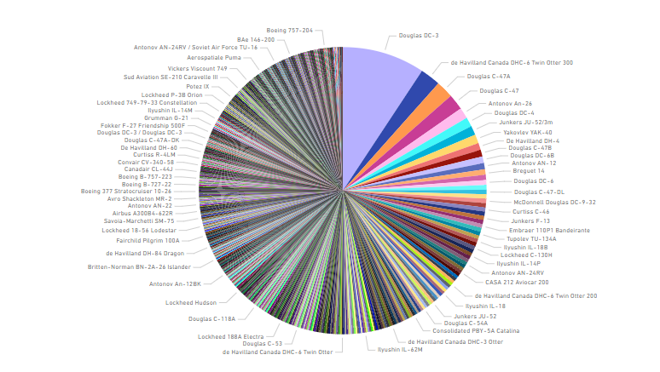
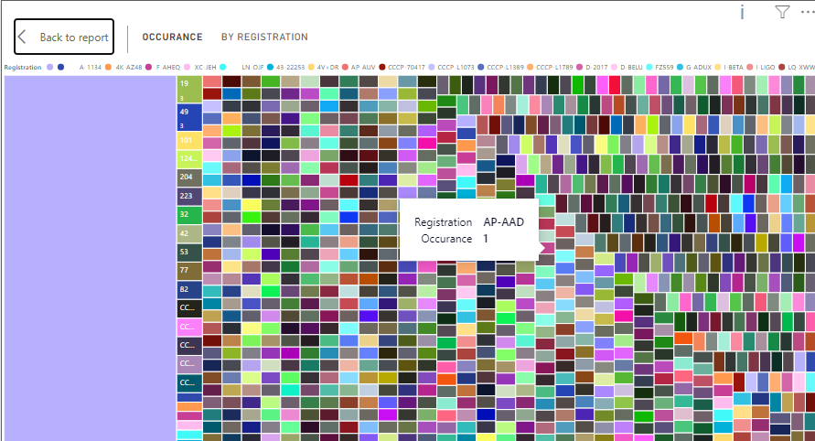
Aircraft Analysis: - Analyze the involvement of specific aircraft types in incidents. - Examine the relationship between aircraft registration and crash occurrences.

Slide 13
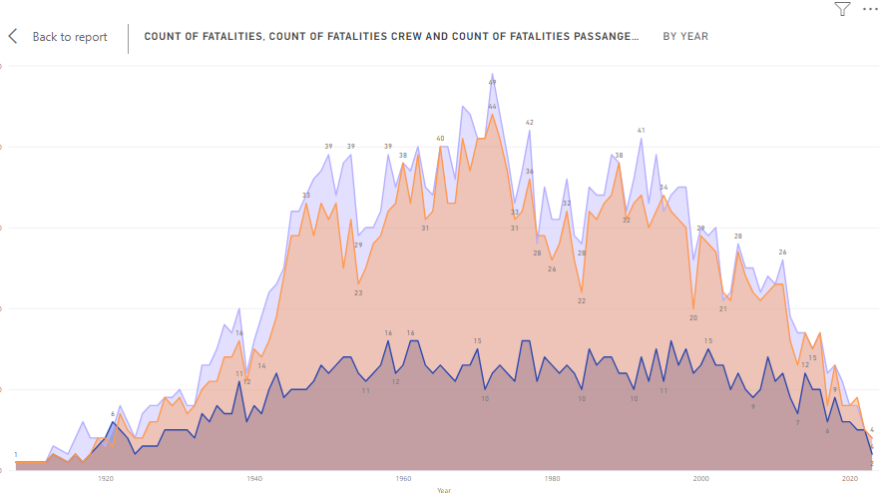
Fatality Trends: - Explore trends in passenger and crew fatalities. - Investigate factors contributing to fatalities.

Slide 14
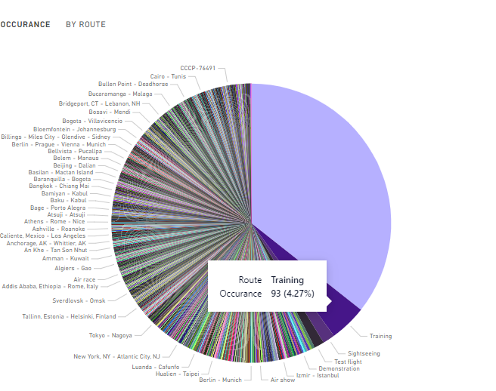
Route Analysis: - Analyze incident patterns on specific flight routes. - Identify routes with a higher likelihood of incidents.

Slide 15
CONCLUSION :
In conclusion, our analysis of airplane crashes from 1980 to 2023, utilizing Power BI, has revealed crucial insights into aviation safety trends and contributing factors. Through detailed examination of temporal, geospatial, and operational data, we have identified areas for improvement and provided actionable recommendations to enhance aviation safety measures and mitigate risks effectively.

Slide 16
THANK YOU

